Slide 1
Antennas and Propagation
Chapter 2

Slide 2
Introduction
An antenna is an electrical conductor or system of conductors
  Transmission - radiates electromagnetic energy into space
  Reception - collects electromagnetic energy from space
In two-way communication, the same antenna can be used for transmission and reception

Slide 3
Radiation Patterns
Radiation pattern
  Graphical representation of radiation properties of an antenna
  Depicted as two-dimensional cross section
Beam width (or half-power beam width)
  Measure of directivity of antenna
Reception pattern
  Receiving antenna’s equivalent to radiation pattern

Slide 4
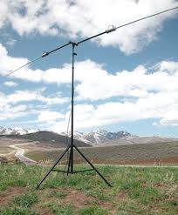
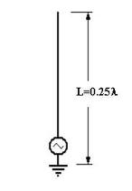
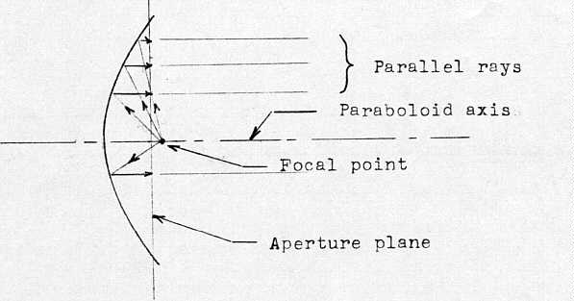
Types of Antennas
Isotropic antenna (idealized)
  Radiates power equally in all directions
Dipole antennas
  Half-wave dipole antenna (or Hertz antenna)
  Quarter-wave vertical antenna (or Marconi antenna)
Parabolic Reflective Antenna

Slide 5
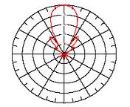
Antenna Gain
Antenna gain
  Power output, in a particular direction, compared to that produced in any direction by a perfect omnidirectional antenna (isotropic antenna)
Effective area
  Related to physical size and shape of antenna

Slide 6
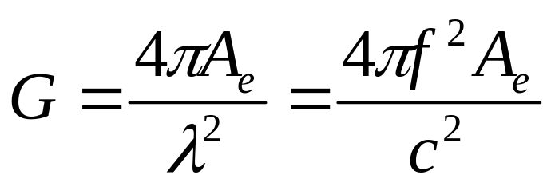
Antenna Gain
Relationship between antenna gain and effective area
    G = antenna gain
    A_{e} = effective area
    f = carrier frequency
    c = speed of light (» 3 × 10⁸ m/s)
    λ = carrier wavelength

Slide 7
Propagation Modes
Ground-wave propagation
Sky-wave propagation
Line-of-sight propagation

Slide 8
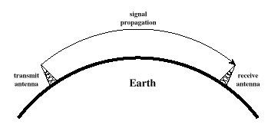
Ground Wave Propagation

Slide 9
Ground Wave Propagation
Follows contour of the earth
Can Propagate considerable distances
Frequencies up to 2 MHz
Example
  AM radio

Slide 10
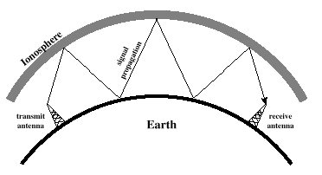
Sky Wave Propagation

Slide 11
Sky Wave Propagation
Signal reflected from ionized layer of atmosphere back down to earth
Signal can travel a number of hops, back and forth between ionosphere and earth’s surface
Reflection effect caused by refraction
Examples
  Amateur radio
  Citizen band (CB) radio

Slide 12
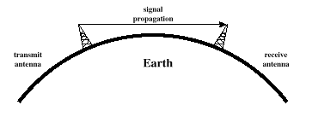
Line-of-Sight Propagation

Slide 13
Line-of-Sight Propagation
Transmitting and receiving antennas must be within line of sight
  Satellite communication – signal above 30 MHz not reflected by ionosphere
  Ground communication – antennas within effective line of site due to refraction
Refraction – bending of microwaves by the atmosphere
  Velocity of electromagnetic wave is a function of the density of the medium
  When wave changes medium, speed changes
  Wave bends at the boundary between mediums

Slide 14
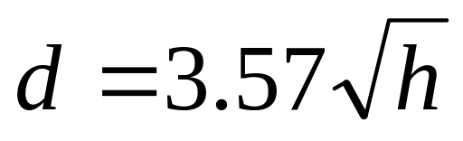
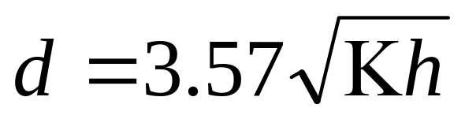
Line-of-Sight Equations
Optical line of sight
Effective, or radio, line of sight
    d = distance between antenna and horizon (km)
    h = antenna height (m)
    K = adjustment factor to account for refraction, rule of thumb K = 4/3

Slide 15
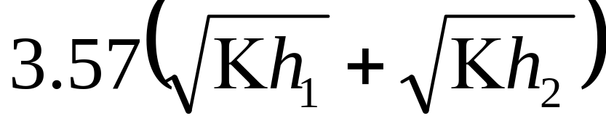
Line-of-Sight Equations
Maximum distance between two antennas for LOS propagation:
    h₁ = height of antenna one
    h₂ = height of antenna two

Slide 16
LOS Wireless Transmission Impairments
Attenuation and attenuation distortion
Free space loss
Noise
Atmospheric absorption
Multipath
Refraction
Thermal noise

Slide 17
Attenuation
Strength of signal falls off with distance over transmission medium
Attenuation factors for unguided media:
  Received signal must have sufficient strength so that circuitry in the receiver can interpret the signal
  Signal must maintain a level sufficiently higher than noise to be received without error
  Attenuation is greater at higher frequencies, causing distortion

Slide 18
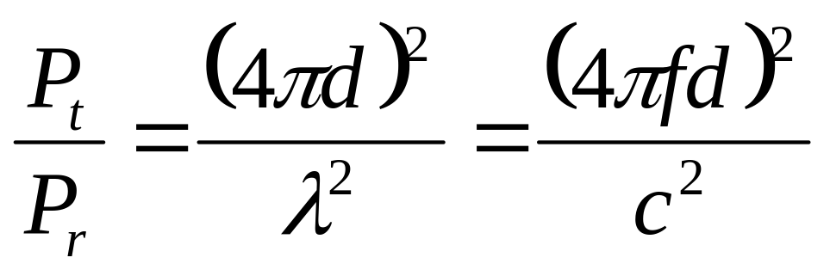
Free Space Loss
Free space loss, ideal isotropic antenna
    P_{t} = signal power at transmitting antenna
    P_{r} = signal power at receiving antenna
    λ = carrier wavelength
    d = propagation distance between antennas
    c = speed of light (» 3 × 10⁸ m/s)
    where d and λ are in the same units (e.g., meters)

Slide 19
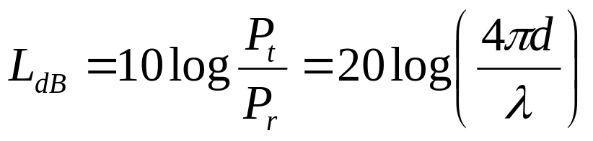
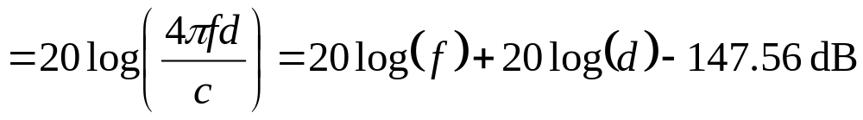
Free Space Loss
Free space loss equation can be recast:

Slide 20
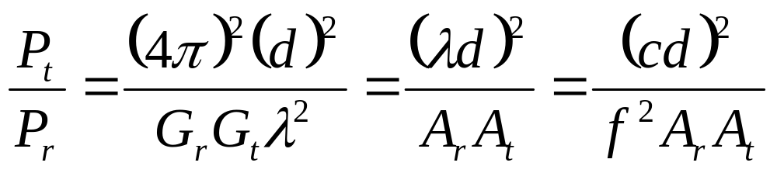
Free Space Loss
Free space loss accounting for gain of other antennas
    G_{t} = gain of transmitting antenna
    G_{r} = gain of receiving antenna
    A_{t} = effective area of transmitting antenna
    A_{r} = effective area of receiving antenna

Slide 21
Free Space Loss
Free space loss accounting for gain of other antennas can be recast as

Slide 22
Categories of Noise
Thermal Noise
Intermodulation noise
Crosstalk
Impulse Noise

Slide 23
Noise Terminology
Intermodulation noise – occurs if signals with different frequencies share the same medium
  Interference caused by a signal produced at a frequency that is the sum or difference of original frequencies
Crosstalk – unwanted coupling between signal paths
Impulse noise – irregular pulses or noise spikes
  Short duration and of relatively high amplitude
  Caused by external electromagnetic disturbances, or faults and flaws in the communications system

Slide 24
Thermal Noise
Thermal noise due to agitation of electrons
Present in all electronic devices and transmission media
Cannot be eliminated
Function of temperature
Particularly significant for satellite communication

Slide 25
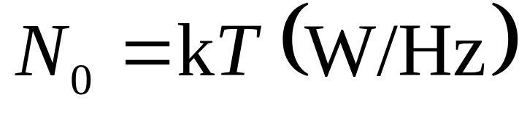
Thermal Noise
Amount of thermal noise to be found in a bandwidth of 1Hz in any device or conductor is:
    N₀ = noise power density in watts per 1 Hz of bandwidth
    k = Boltzmann's constant = 1.3803 ×10⁻²³ J/K
    T = temperature, in kelvins (absolute temperature)

Slide 26

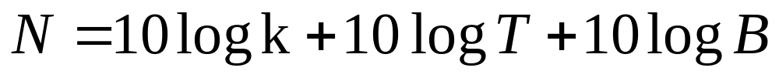
Thermal Noise
Noise is assumed to be independent of frequency
Thermal noise present in a bandwidth of B Hertz (in watts):
    or, in decibel-watts

Slide 27
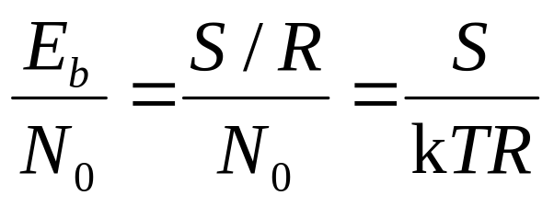
Expression E_{b}/N₀
Ratio of signal energy per bit to noise power density per Hertz
The bit error rate for digital data is a function of E_{b}/N₀
  Given a value for E_{b}/N₀ to achieve a desired error rate, parameters of this formula can be selected
  As bit rate R increases, transmitted signal power must increase to maintain required E_{b}/N₀

Slide 28
Other Impairments
Atmospheric absorption – water vapor and oxygen contribute to attenuation
Multipath – obstacles reflect signals so that multiple copies with varying delays are received
Refraction – bending of radio waves as they propagate through the atmosphere

Slide 29
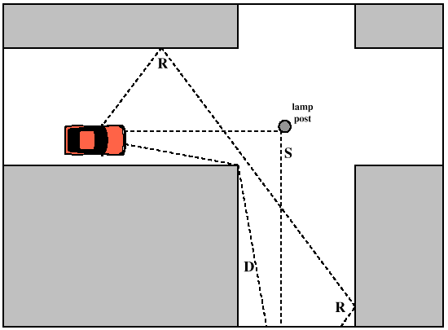
Multipath Propagation

Slide 30
Multipath Propagation
Reflection - occurs when signal encounters a surface that is large relative to the wavelength of the signal
Diffraction - occurs at the edge of an impenetrable body that is large compared to wavelength of radio wave
Scattering – occurs when incoming signal hits an object whose size in the order of the wavelength of the signal or less

Slide 31
The Effects of Multipath Propagation
Multiple copies of a signal may arrive at different phases
  If phases add destructively, the signal level relative to noise declines, making detection more difficult
Intersymbol interference (ISI)
  One or more delayed copies of a pulse may arrive at the same time as the primary pulse for a subsequent bit

Slide 32
Fading in the mobile environment
Fading – time variations of the received signal power caused by changes in the transmission medium or path.
Characterized by three factors: space, time, frequency.

Slide 33
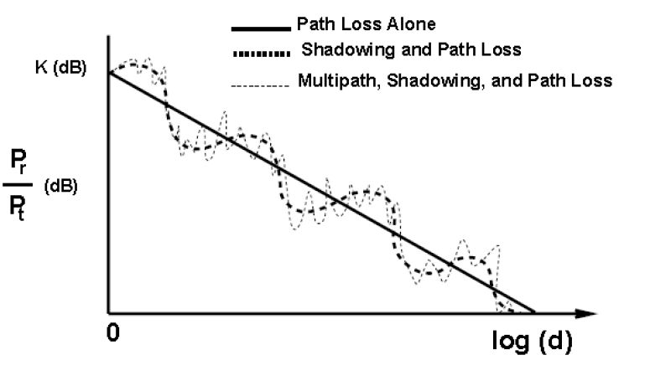
Fading

Slide 34
Types of Fading
Characterized by time:
  Fast fading – rapidly changing fading over very short distance, e.g. travelling in a high-speed car
  Slow fading – slowly changing fading, e.g. passing a tree or building

Slide 35
Types of Fading (cont’d)
Characterized by frequency:
  Flat fading – all frequency components of the received signal fluctuate in the same proportions simultaneously. e.g. multipath with negligible delays.
  Selective fading – affects unequally the different spectral components of a radio signal, e.g. multipath with large delays

Slide 36
Types of Fading (cont’d)
Characterized by space:
  Rayleigh fading – when there are multiple indirect radio signal paths between transmitter and receiver, and no direct path.
  Rician fading – when there is a LOS path in addition to a number of indirect paths.
    K = (power in the LOS path)/(power in the scattered paths)

Slide 37
Error Compensation Mechanisms
Forward error correction (chap. 5)
Adaptive equalization
  used in modems
Diversity techniques
  used in multi-antenna systems

